Slide 1
Chapter 3b: Basic Switching Concepts and Configuration (II)
Routing and Switching
Notes:
Cisco Networking Academy program
Routing & Switching
Chapter 2: Introduction to Switched Networks

Slide 2
Chapter 2b: Objectives
Upon completion of this chapter, you will be able to:
Describe basic security attacks in a switched environment.
Describe security best practices in a switched environment.
Notes:
2.

Slide 3
Secure Remote Access
SSH Operation
Secure Shell (SSH) is a protocol that provides a secure (encrypted), command-line based connection to a remote device.
SSH is commonly used in UNIX-based systems and is supported on Cisco IOS software.
SSH should replace Telnet for management connections because Telnet traffic transmits username and password in plaintext.
SSH uses TCP port 22 while Telnet use TCP port 23.
Notes:
2.2.1.1 SSH Operation

Slide 4
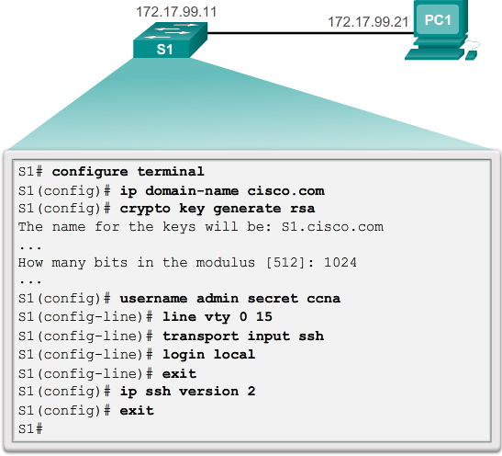
Secure Remote Access
Configuring SSH
Notes:
2.2.1.2 Configuring SSH

Slide 5
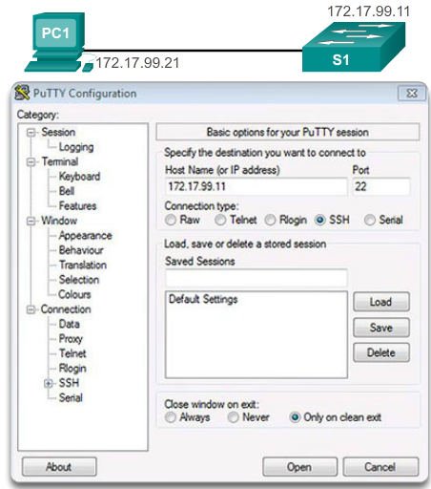
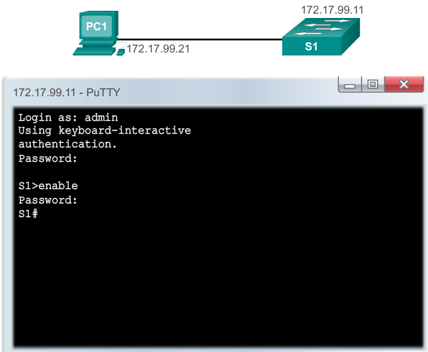
Secure Remote Access
SSH Access
A SSH software (eg. Putty) is required to remotely access the Cisco device via the virtual terminal
Notes:
2.2.1.1 SSH Operation

Slide 6
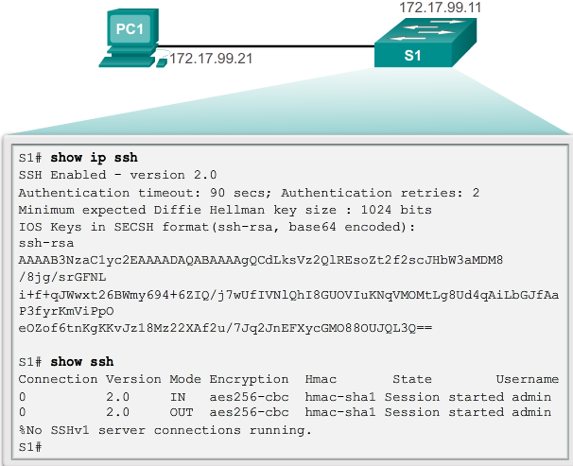
Secure Remote Access
Verifying SSH
Notes:
2.2.1.2 Verifying SSH

Slide 7
Security Concerns in LANs
MAC Address Flooding
A switch automatically populates its MAC address table from incoming traffic into its ports.
It broadcasts traffic through all other ports if the destination MAC is not in the MAC address table.
  When this happens, the switch is acting like a hub.
  Unicast traffic can be seen by all devices connected to the switch.
Notes:
2.2.2.1 MAC Address Flooding

Slide 8
Security Concerns in LANs
MAC Address Flooding (cont.)
An attacker wanting to gain access to actual network traffic can exploit this behavior by using a PC connected to the network and running a MAC flooding software.
  The software generates and sends out frames with fake source MAC addresses to the switch port.
  The switch adds the fake MAC address to its MAC address table, taking note of the port the frames arrived.
  Eventually the MAC address table is full with fake MAC addresses with no more room for actual devices present in the network and, therefore, never finds their MAC addresses in the CAM table.
  All frames are now forwarded to all ports, allowing the attacker to access traffic to other hosts.
How can we mitigate this kind of attack?
  Answer: _______ security
Notes:
2.2.2.1 MAC Address Flooding

Slide 9
Security Concerns in LANs
DHCP Spoofing
DHCP is a network protocol used to automatically assign IP information to DHCP-enabled devices
Two types of DHCP attacks are:
  DHCP starvation
    An attacker floods the DHCP server with DHCP requests to use up all available IP addresses that the DHCP server can issue.
    As a result, the server cannot issue any more IP addresses.
  DHCP spoofing
    a fake DHCP server is placed in the network to issue DHCP addresses to clients which diverts clients to use false Domain Name System (DNS) under the control of the attacker, as their default gateway.
    DHCP starvation is often used before a DHCP spoofing attack to deny end users service to the legitimate DHCP server.
Notes:
2.2.2.2 DHCP Spoofing

Slide 10
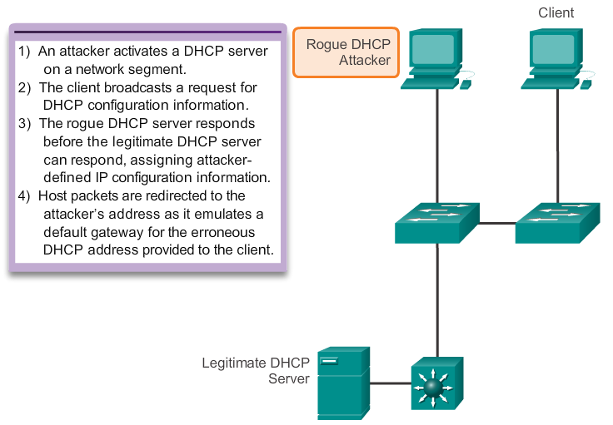
Security Concerns in LANs
DHCP Spoof Attack
Notes:
2.2.2.2 DHCP Spoof Attack

Slide 11
Security Concerns in LANs
Leveraging Telnet
The Telnet protocol is insecure and should be replaced by SSH.
An attacker can use Telnet as part of other attacks:
  Information is transmitted in clear text
  Brute force password attack
  Telnet DoS attack
When passwords cannot be captured, attackers will try as many combinations of characters as possible. This attempt to guess the password is known as brute force password attack.
Telnet can be used to test the guessed password against the system.
Notes:
2.2.2.4 Leveraging Telnet

Slide 12
Security Concerns in LANs
Leveraging Telnet (cont.)
In a Telnet DoS attack, the attacker exploits a flaw in the Telnet server software running on the switch that renders the Telnet service unavailable.
This sort of attack prevents an administrator from remotely accessing switch management functions.
This can be combined with other direct attacks on the network as part of a coordinated attempt to prevent the network administrator from accessing core devices during the breach.
Vulnerabilities in the Telnet service that permit DoS attacks to occur are usually addressed in security patches that are included in newer Cisco IOS revisions.
Notes:
2.2.2.4 Leveraging Telnet

Slide 13
Security Best Practices
10 Best Practices
Develop a written security policy for the organization.
Shut down unused services and ports.
Use strong passwords and change them often.
Control physical access to devices.
Use HTTPS instead of HTTP.
Perform backup operations on a regular basis.
Educate employees about social engineering attacks.
Encrypt and password-protect sensitive data.
Implement firewalls.
Keep software up-to-date.
Notes:
2.2.3.1 10 Best Practices

Slide 14
Chapter 3b: Summary
In this chapter, you learned:
SSH is a secure replacement for Telnet
The basic attacks on network devices
Best practices for switched networks.
Notes:
Chapter 2 Summary

